Slide 1
Adaboost algorithm
Ensemble ML algorithms
AdaBoost = Adaptive Boosting
Combining multiple weak models(small decision tree) to form a strong model
Improve predictions by correcting the previous errors

Slide 2
How it works?
Starts with a weak model (e.g., Decision Tree with depth=1)
Calculates prediction error
Adjusts weights → gives more focus to hard-to-predict data
Repeats this for multiple models (boosting)
Final prediction = weighted average of all models

Slide 3
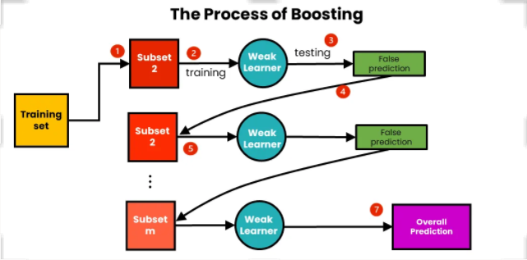
Process

Slide 4
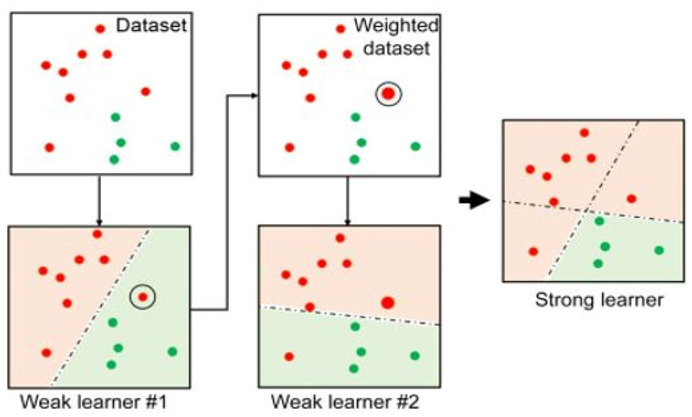

Slide 5
Why Adaboost?
Captures non-linear patterns
Improves over simple models
Performs well with small to medium datasets
Can reach high accuracy with proper tuning

